Slide 1
WeCode
Mobile Application Development Bootcamp 2021-2022

Slide 2
Week #1 > Lecture 1
Version Control and Git
Notes:
Hello every one and welcome to Week one of the Mobile Application bootcamp

Slide 3
Version control is a system that records changes to a file or a set of files over time so that you can recall specific versions later. Also allows developers to work together and maintain codebase history without overriding each other code.
Notes:
Version control software keeps track of every modification to the code in a special kind of database. If a mistake is made, developers can turn back the clock and compare earlier versions of the code to help fix the mistake while minimizing disruption to all team members.

Slide 4
Git is a distributed version control system. This means that a local clone of the project is a complete version control repository. These fully-functional local repositories make it is easy to work offline or remotely. Developers commit their work locally, and then sync their copy of the repository with the copy on the server. This paradigm differs from centralized version control where clients must synchronize code with a server before creating new versions of code.
Working Directory
Git add
Staging Level
Git commit
Repository
Notes:
Real life projects generally have multiple developers working in parallel. So a version control system like Git is needed to ensure there are no code conflicts between the developers.
Additionally, the requirements in such projects change often. So a version control system allows developers to revert and go back to an older version of the code.
And sometimes several projects which are being run in parallel involve the same codebase. In such a case, the concept of branching in Git is very important.
Basic Git workflow
Has three steps
Working directory, staging area and the repository
So you edit files on your directory and want to add it to your repository, git has staging area, which tells git to track the file.
The staging area holds the changes we propose to commit to our repository, before committing we might need to check if we’ve done everything correctly and didn’t add our Key files into the repository.

Slide 5
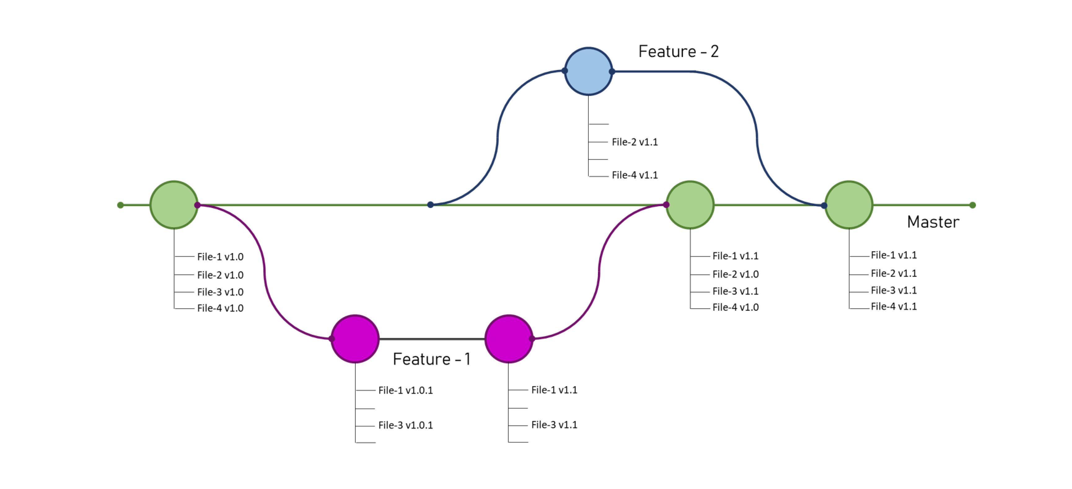
Git Branch
Notes:
Using git, Each developer saves changes their own local code repository. As a result, there can be many different changes based off the same commit. Git provides tools for isolating changes and later merging them back together. Branches, which are lightweight pointers to work in progress, manage this separation. Once work created in a branch is finished, it can be merged back into the team's main (or trunk) branch.

Slide 6
Install required tools
Download and install Git for your operating system from this link
Download and install Github Desktop for your operating system from this link
Download and install VS Code for your operating system from this link

Slide 7
What is Github?
GitHub is a for-profit company that offers a cloud-based Git repository hosting service. Essentially, it makes it a lot easier for individuals and teams to use Git for version control and collaboration.
GitHub's interface is user-friendly enough so even new coders can take advantage of Git. Without GitHub, using Git generally requires a bit more technical knowledge and use of the command line.
Notes:
GitHub is a for-profit company that offers a cloud-based Git repository hosting service. Essentially, it makes it a lot easier for individuals and teams to use Git for version control and collaboration.
GitHub's interface is user-friendly enough so even new coders can take advantage of Git. Without GitHub, using Git generally requires a bit more technical knowledge and use of the command line.
GitHub is so user-friendly, though, that some people even use GitHub to manage other types of projects – like writing books.
Additionally, anyone can sign up and host a public code repository for free, which makes GitHub especially popular with open-source projects.

Slide 8
GIT OPERATIONS YOU MUST KNOW

Slide 9
The git status command shows the state of the working directory and the staging( Before Commit ) area.
git --status
Notes:
The git status command shows the state of the working directory and the staging( Before Commit ) area.

Slide 10
Commits are snapshots of your code with a message attached. to commit latest changes using CLI, on the Terminal opened in a git repository folder type:
git commit -m your "message or comment about changes you have done"
Notes:
Commits are snapshots of your code with a message attached.
Always remember to add a meaningful message, so you and your colleagues know the exact thing you’ve done.

Slide 11
Git fetch downloads content from the specified remote repository.
git fetch
Git merge Joins two or more development histories together.
git merge
The git push command is used to upload local repository content to a remote repository.
git push
Notes:
Git fetch downloads content from the specified remote repository, for example from your repository on GitHub.
Git merge will combine multiple sequences of commits into one unified history. In the most frequent use cases, git merge is used to combine two branches.
The git push command is used to upload local repository content to a remote repository. Pushing is how you transfer commits from your local repository to a remote repo

Slide 12
in class assignment (15 min):
On your GitHub profile create a repository named “Wecode1_yourname” add text file in which includes your name and your bio as two separate commits.

Slide 13
What is Git Fork
A fork is a rough copy of a repository. Forking a repository allows you to freely test and debug with changes without affecting the original project. One of the excessive use of forking is to propose changes for bug fixing.
Notes:
A fork is a rough copy of a repository. Forking a repository allows you to freely test and debug with changes without affecting the original project. One of the excessive use of forking is to propose changes for bug fixing. To fork a repository on the repository page on upper right section chose fork to have a copy of the repository on your account.

Slide 14
What is Pull Request
A pull request in GitHub is a request to the maintainer of a repository to pull in some code. When you write some code that you want to contribute to a repository, you create and submit a pull request. Your code contains some proposed changes to the target repository. A pull request is your way of offering these changes to the maintainer of the repository. It gives the repository maintainers an opportunity to review the changes and either accept them, reject them, or ask for more changes to be made.
Notes:
A pull request in GitHub is a request to the maintainer of a repository to pull in some code. When you write some code that you want to contribute to a repository, you create and submit a pull request. Your code contains some proposed changes to the target repository. A pull request is your way of offering these changes to the maintainer of the repository. It gives the repository maintainers an opportunity to review the changes and either accept them, reject them, or ask for more changes to be made.

Slide 15
How to create a repository?
Login to your Account
Go to your Repositories Section(Click on Your profile image>choose Your repositories)
Click on the green button with New label
On Repository name field enter a name for your repository
If you want anyone on the internet be able to see your codebase, choose Public, if not choose Private
Click on create repository
you can initialize your repository with a readme file or add .gitignore license to your project
Notes:
First Login to your Account
Then navigate to your Repositories Section(Click on Your profile image>choose Your repositories)
Then Click on the green button with New label text on it
On Repository name field enter a name for your repository
If you want anyone on the internet be able to see your codebase, choose Public, if not choose Private
Click on create repository
you can initialize your repository with a readme file or add .gitignore license to your project

Slide 16
How to clone a repository?
Select the repository you want to clone on your device
Click on the green dropdown button labeled Code
Copy the web url below the HTTPS tab
On your desktop system cd into the folder you want the repository to be cloned to: cd Desktop/development/, on window the command will be a slightly diffrent one.
Type the clone command and paste the repository url: git clone https://github.com/hooshyar/sample1.git
Notes:
How to clone a repository and add it to your device?

Slide 17
Assignment 2 (20 hours):
Create a pull request for this repository and add your Github, LinkedIn and Stack-overflow profile to it.
Try not to have conflict with main the original repo
Add clear title and comments

